Slide 1
Lecture 2: HTML

Slide 2
HTML: Questions over reading
CH 3 - Basic HTML Structure
HTML Structure?
Parts of a document
<header>, <footer>, <aside>?
Naming elements
Classes
CH 6 - Links
Block Level Links
Wrapping elements in anchor tag
Target Attribute

Slide 3
HTML: Last Week Review
Hyper Text Markup Language
Think of as a Skeleton
Holds everything together
Cascading Style Sheets
Think of as Clothes
Styling of website
JavaScript
Think of as Muscles
Creates functionality
<!DOCTYPE html>
Declares file
<html>
Begins the HTML content
<head>
Instructional information for page
Meta tags
<title>
External CSS
<body>
Content user sees

Slide 4
HTML: Last Week Review contd.
CSS Selectors
.class
Reuseable
<div class=”myClass”>...</div>
#id
Unique element
<div id=”myId”>...</div>
*
Selects all elements
element
Selects all same HTML elements
<p>...</p>
.myClass {...css props...}
#myId{...css props…}
*{...css props…}
p{...css props…}
CSS Selector Reference

Slide 5
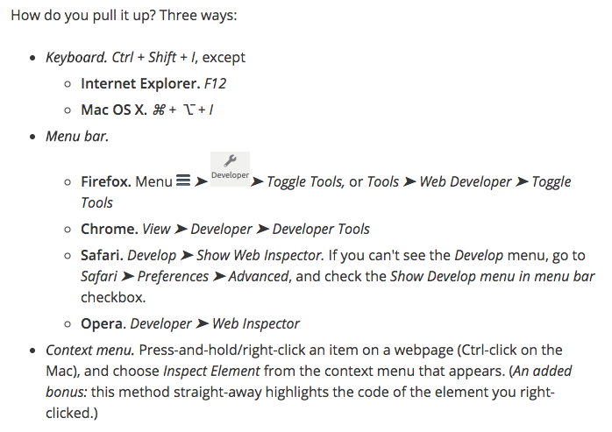
HTML: Last Week Review contd.
Chrome Developer tools
In creating websites and web applications one of the most important tools is the developer tools.
Every modern web browser includes a powerful suite of developer tools. These tools do a range of things, from inspecting currently-loaded HTML, CSS and JavaScript to showing which assets the page has requested and how long they took to load.
What are developer tools?

Slide 6
HTML: Last Week Review contd.
Vendor Prefixes
Browser vendors sometimes add prefixes to experimental or nonstandard CSS properties and JavaScript APIs, so developers can experiment with new ideas while—in theory—preventing their experiments from being relied upon and then breaking web developers' code during the standardization process. Developers should wait to include the unprefixed property until browser behavior is standardized.
webkit-
Chrome
Safari
Newer version of Opera
iOS browsers
moz-
Firefox
o-
Pre-WebKit versions of Opera
ms-
Internet Explorer
Microsoft Edge

Slide 7
HTML: Goals
Our goals for tonight
Verify wireframes for
Homepage
About
Discography
Verify band selection
Setup personal computers
Setup Class Directory on storage device
Sign up for
Box
Google Drive
Dropbox
USB Drive or Laptop
Understand HTML
Semantics
Directory Structure
Images, Text, Links
URLs
Element Relationships
SEO
Accessibility

Slide 8
HTML: Help Resources
StackOverflow - HTML
W3Schools
HTML Cheatsheet

Slide 9
HTML: Web Pages
It's impossible to create a web page without HTML
New front end frameworks like Angular and ReactJS require HTML but in different ways
Angular Example
React Example
Ruby on Rails Example
Web Browsers are designed to render HTML for users
A web page consists of 3 primary components
Text Content - bare text that tells the user what your page or site is about
References to other files - items such as images, audio, video files or other HTML files
Assets - JavaScripts or CSS files
Markup - HTML Elements
These files are all saved as text so they can be universally read by browsers
There is other information contained in the files not viewable by users
Content in the <head>...</head>
The <head> contains character encoding usually UTF-8 and other information for the browser and search engines

Slide 10

HTML Exercise: Setting up Class Directory
Select the storage option
Laptop
USB Drive
Cloud Storage
/class-directory
/assets
/images
.gitkeep
/stylesheets
styles.css
/javascripts
.gitkeep
index.html

Slide 11
HTML: Code Structure
Let’s create our index.html file basic
Once complete run atom-live-server
<!DOCTYPE html>
<html lang=“en”>
<head>
<meta charset=“utf-8” />
<title></title>
</head>
<body></body>
</html>

Slide 12
HTML: Semantics
HTML is a text document containing “markup”.
Markup describes the meaning
The meaning is the Semantics
HTML doesn’t define how things look, that’s for CSS.
Every browser has some default styling
Elements
Before HTML5 there were 2 types of presentation elements
Block - has its’ own line
Inline - displays in a line of text
HTML5 does away with these concepts because presentation is for CSS
Block elements fall into various new HTML definitions based on their semantics
Inline is now “phasing content”

Slide 13
HTML: Semantics contd.
HTML was a few years old when CSS1 arrived in 1996. Because of this HTML had to handle some presentation qualities
Lots of text styles for example
Bold
Italic
Sizing
HTML presentation fell out of favor with HTML 4 instead pushed towards CSS styling
HTML5 goes further to make elements less presentational and more semantic
In the end choose tags that describe the content regardless of prestación al effects

Slide 14
HTML: Write Semantic Code
Notes:
Will take the base index file and start writing with tags
h1 - h6 tags
Paragraph tag
Image tag pull in image from http://placehold.it
Section tag
Article
Main
Em
Strong
Anchor tag

Slide 15
HTML: Why Semantics matters
Accessibility
Users with some type of impairment usually visual
HTML is meant to be universal and all users should be able to view and digest content
YouTube: Introduction to Web Accessibility and W3C Standards
YouTube: Why do semantics matter?
Improved SEO
Search Engine Optimization
Search engines look for particular tags on pages and these will be used as part of your site rating
Beginner Guide to SEO
Google Analytics Demo
Styling and maintenance
If we are coding to the same standard it makes for a better experience picking up new code more efficiently
Makes writing CSS easier and developer understanding

Slide 16
HTML: Markup Elements, Attributes, and Values
HTML has 3 principal components: elements, attributes, and values
Elements - labels that describe parts of a page
<p>, <h#>, <a>, <em>, <img />, etc.
Elements must have a start and stop, however <img /> for example is an “Empty Element” tag meaning it closes without having to declare </img>.
Yes: <img src=”...” alt=”...” />
No: <img src=”...” alt=”...”></img>
Attributes and Values - attributes contain information about the content in the document, not the content itself
<a href=”google.com” target=”_blank”>Google</a>
href is the attribute | “google.com” is the value of href
You can have one or more attributes.
Some attributes have predefined values

Slide 17
HTML: Parent > Child
Parents and Children - an HTML element that contains another HTML element is considered a “Parent Child relationship”
Ex. <article><p>...some text...</p></article> | The <article> is the Parent to the Child <p>
Parents can have theoretically infinite nested children although this isn’t advised. “nested children” <article><p>...some text…<ul><li>...</li></ul></p></article>
Parent Child relationships are extremely important to understand when you begin working with CSS and JavaScript

Slide 18
HTML: Links, Images, and non-text content
Since everything in an HTML document is text anything that isn’t text is merely a reference
The reference is nothing more than text
Browsers are able to interpret all types of files but depending on the browser it may not support particular files
Browsers will do their best in finding a supporting application to assist in supporting unsupported files
You as a developer can also assist in helping browser find applications and extensions to allow the browser to support a non-native file type

Slide 19
HTML: File Names
Use Lowercase File Names
media.html, discography.html, photos.html, etc.
Separate words with a dash ‘-’
tour-dates.html, my-profile.html, super-cool-page.html
Dashes are preferred by Search Engines
Underscores ‘_’ are not wrong just not recommended
Be careful of the extensions you use
proper : .html
improper: .htm
What you declare is what will render .txt will render a text document

Slide 20
HTML: URLs
Uniform Resource Locator (URL) is a name for addresses.
Contains information about where the file is
Parts of a URL
https://www.williamsfuller.com/projects/deftones-site/index.html
Scheme
Not Secure: http://
Secure: https://
Others: ftp, sftp, etc.
Server Name
www.williamsfuller.com
Path
/projects/deftones-site/
File Name
index.html

Slide 21
HTML: URLs contd.
There are 2 types of URLs
Absolute - shows the entire path
https://www.williamsfuller.com/projects/deftones-site/index.html
https://www.williamsfuller.com/projects/deftones-site/assets/stylesheets/styles.css
Relative - details where a file is relative to where you are located
If we were on the index.html page and wanted to reference the styles.css
../assets/stylesheets/styles.css
When working within files you will typically just use relative paths to grab all your reference images, stylesheets, scripts, etc. from within your project. If you are referencing files outside of your project on the web you’d use absolute paths.

Slide 22
HTML Exercises
Notes:
Cover Chapter 3
Create Headings: h1 - h6
<h1>-<h6>
Paragraph
<p>
Image tag and import an image from the internet
Button
<button></button>
<marquee>Make it scroll, baby!</marquee>
<cite>something to cite</cite>
Anchor
<a href=”/path/to/something”>something</a>
https://www.w3schools.com/tags/att_a_target.asp
_blank: Opens the linked document in a new window or tab
_self: Opens the linked document in the same frame as it was clicked (this is default)
_parent: Opens the linked document in the parent frame
_top: Opens the linked document in the full body of the window
Section
Article
Text tags
<b> - Bold text
<strong> - Important text
<i> - Italic text
<em> - Emphasized text
<mark> - Marked text
<small> - Small text
<del> - Deleted text
<ins> - Inserted text
<sub> - Subscript text
<sup> - Superscript text
Image Optimization with TinyPng

Slide 23
HTML: Review
In depth look into HTML
Covered
Tags
URLs
Accessibility
SEO
Semantic code
Got environments setup
Element relationships
File name

Slide 24
Week 3
Homework
Read: Ch 7 & 8
Wireframes
Media
Merch
Tour Dates
Create final project directory and link to all of the pages

